Slide 1
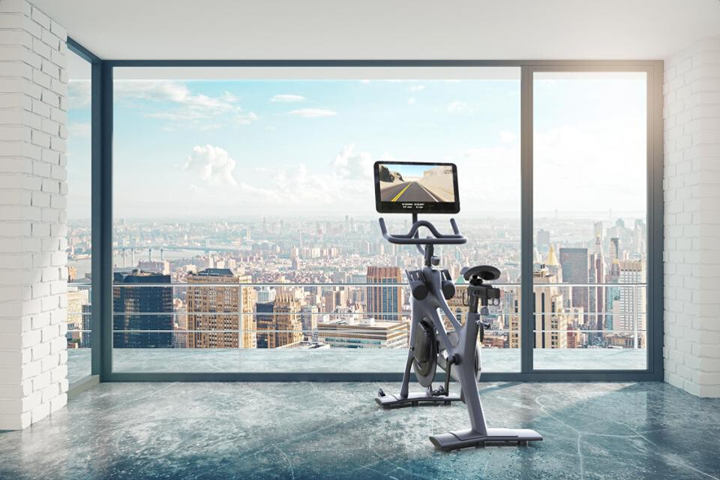



Business Plan | Group 3

Slide 2


Slide 3
OUR PURPOSE
To introduce a new centralized, customizable, and technologically interactive subscription box service that caters to urban active individuals and existing Peloton consumers by delivering a carefully curated box to assist in maximizing their health, fitness, and wellness goals.

Slide 4



Expanding the Peloton Community to All
OUR
PELOTON PROMISE
TO YOU
Convenience for an Urban, On-the-Go Lifestyle
Ever-changing curation of Health and Wellness Product to meet your goals and aspirations

Slide 5


Slide 6

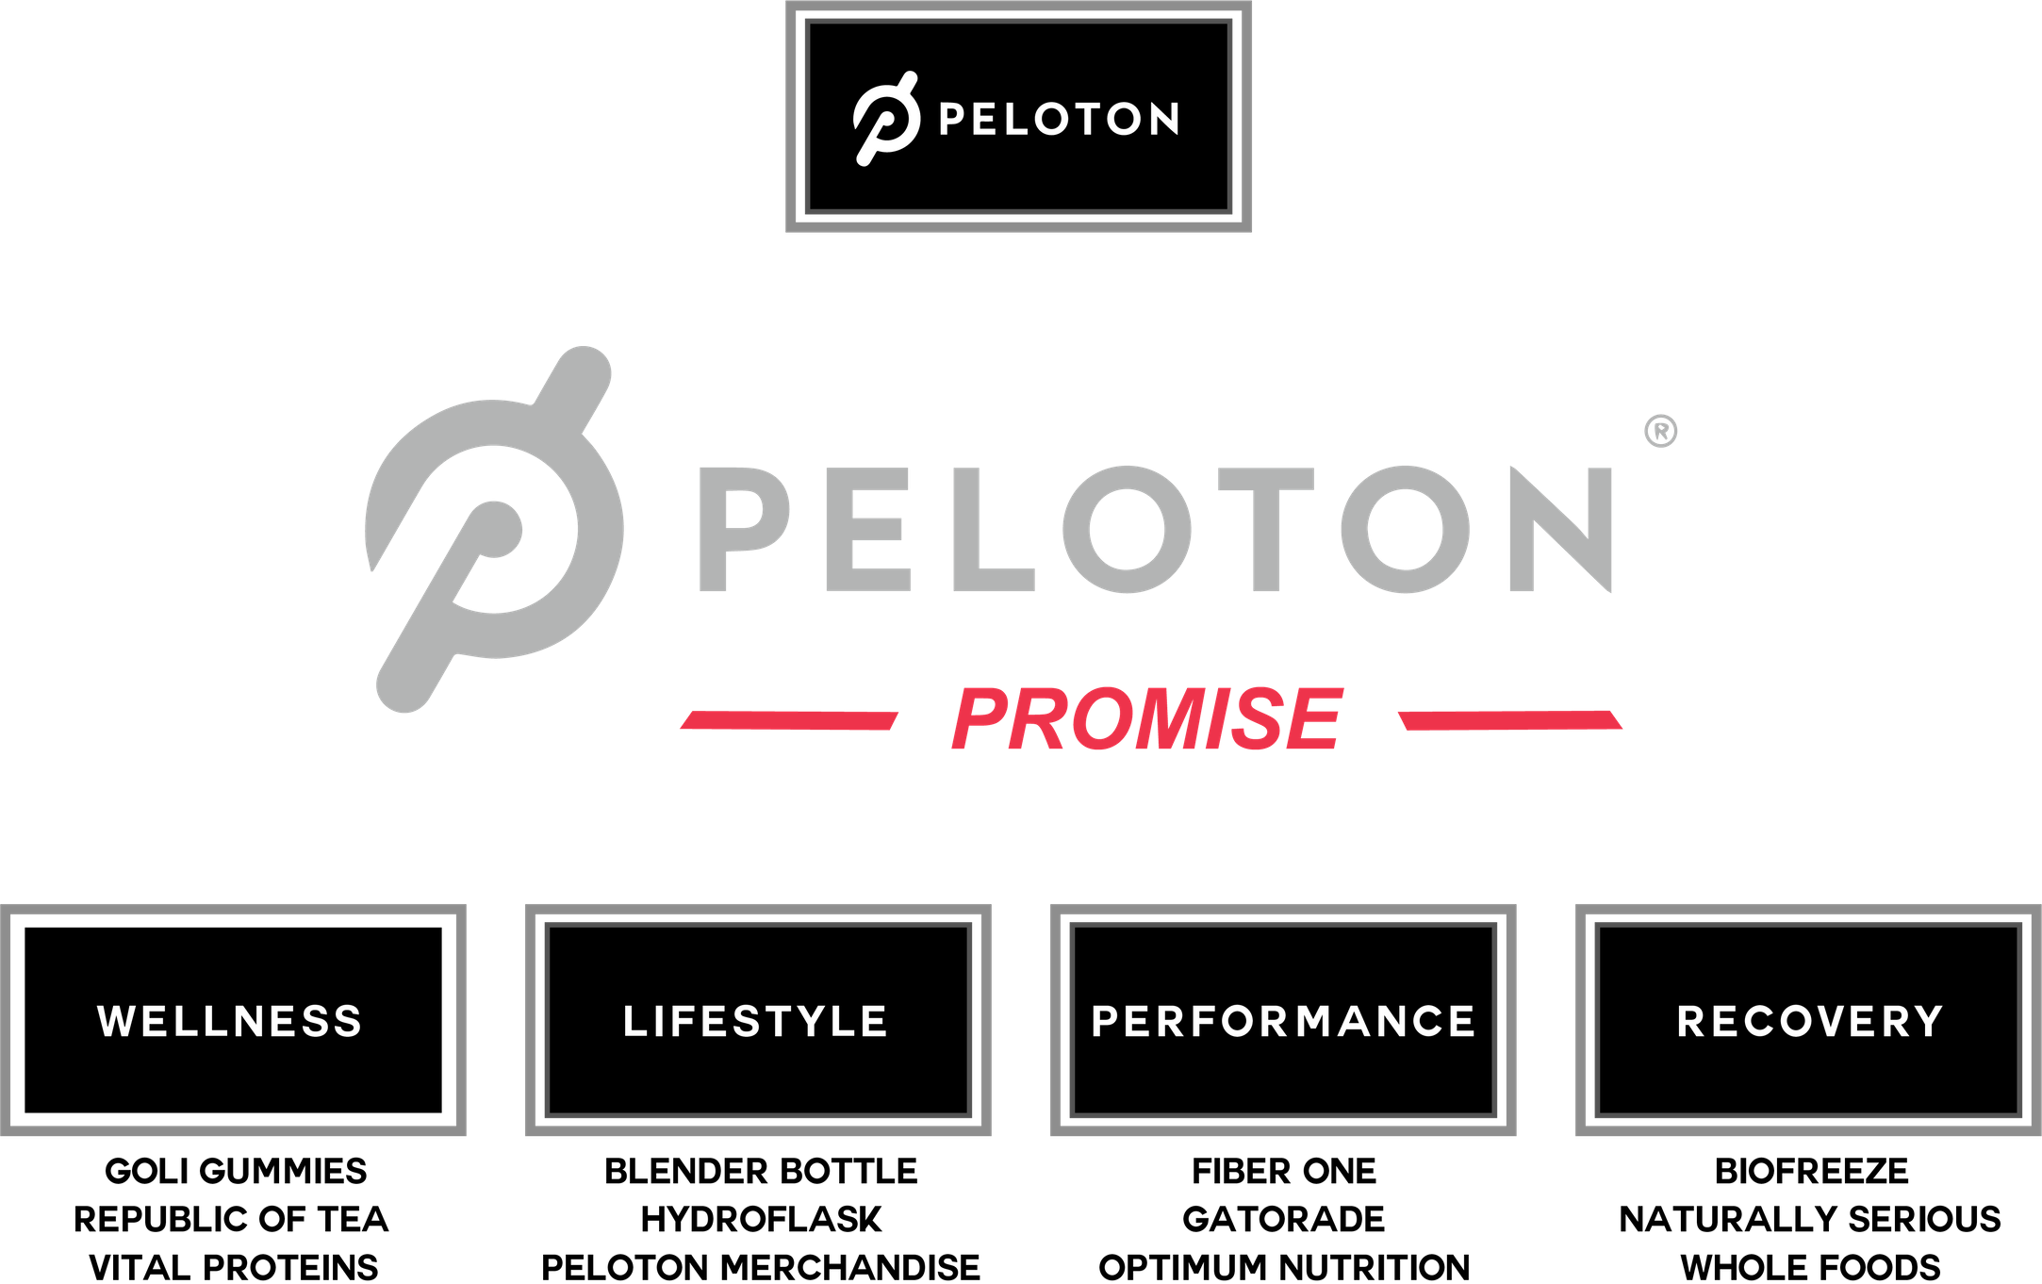

Slide 7
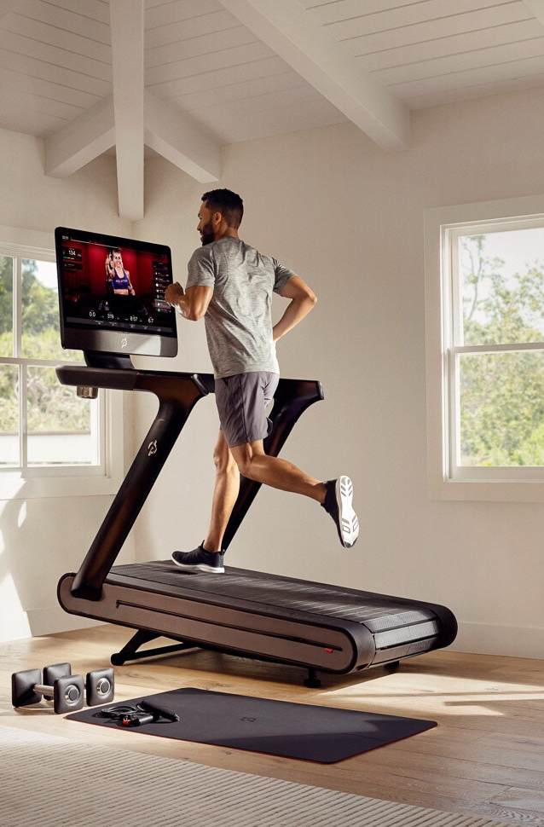



PELOTON PURIFY
CLEANSE YOUR MIND, BODY, AND SOUL
PELOTON POWER
CATERED TO YOU
PURIFY. POWER. PERFORM.
POWER THROUGH IT ALL
PELOTON PERFORMANCE
PRODUCTS TO PERFORM TO THE MAX

Slide 8
THE FINISH LINE
OUR GOAL IS TO SYNERGIZE PELOTON WITH PELOTON PROMISE AS RIDERS IN A RACE SYNERGIZE TOGETHER
Our Promise
Our People
Our Profit
Bring specificity to the subscription service market by offering a carefully curated bi-monthly boxes to enhance the health, wellness, and fitness aspirations of our consumers.
20 to 35-year-old individuals, living in
urban, metropolitan areas, following a
moderately active lifestyle. Earning
annually between $50,000 to $80,000.
Bringing a 27.4% profit to the Peloton Brand. Encouraging current and new consumers to invest in the Peloton Community through a new service channel.

Slide 9
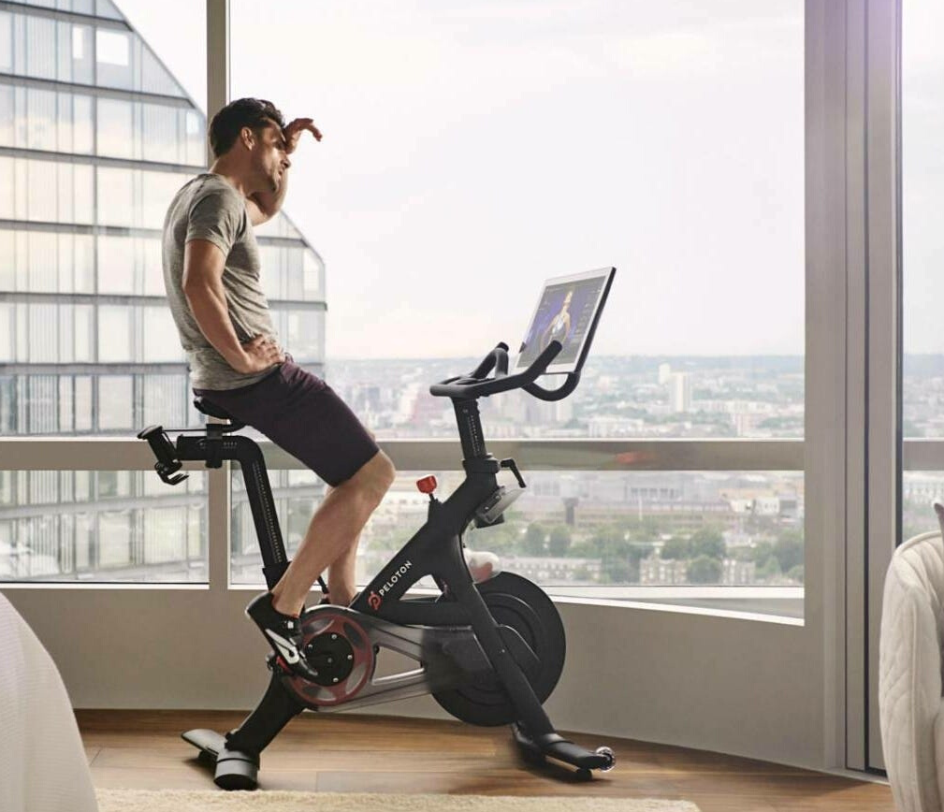

Q&A

